Slide 1
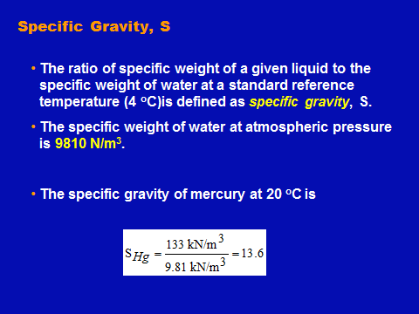
Fluid Mechanics Class Note
Dr. Qassem Hamed Jalut Associate Professor

Slide 2
Fluid Mechanics Class Note
Dr. Qassem Hamed Jalut Associate Professor

Slide 3
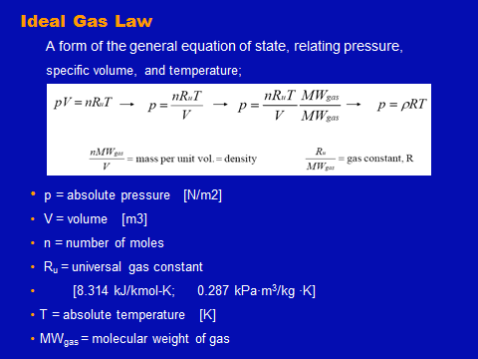
Fluid Mechanics Class Note
Dr. Qassem Hamed Jalut Associate Professor

Slide 4
Fluid Mechanics Class Note
Dr. Qassem Hamed Jalut Associate Professor

Slide 5
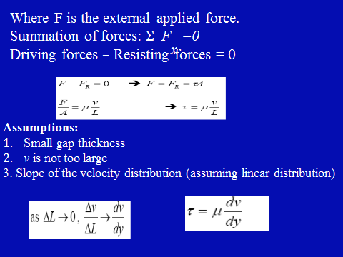
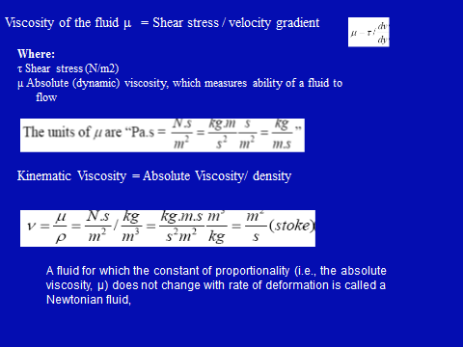
Fluid Mechanics Class Note
Dr. Qassem Hamed Jalut Associate Professor

Slide 6
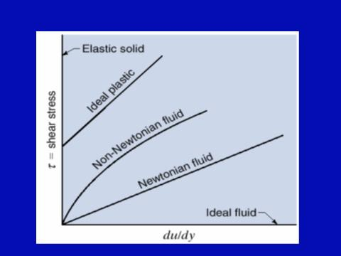
Fluid Mechanics Class Note
Dr. Qassem Hamed Jalut Associate Professor

Slide 7
Fluid Mechanics Class Note
Dr. Qassem Hamed Jalut Associate Professor

Slide 8
Fluid Mechanics Class Note
Dr. Qassem Hamed Jalut Associate Professor
20

Slide 9
Fluid Mechanics Class Note
Dr. Qassem Hamed Jalut Associate Professor
21

